Slide 1




Coding Cat
Ahmad Subaktagin Jabir 16.02.04.061
Arunima Ayshee 16.02.04.066
Rahat Bin Osman 16.02.04.083
Aniqua Tabassum 16.02.04.085

Slide 2
Outline
Introduction to Project
Requirements Specification
Interview and Questionnaire
Conclusion
August 06, 2019
Coding Cat

Slide 3
Introduction to Project
August 06, 2019
Coding Cat

Slide 4
Our Project Coding Cat is an Online Judge where the user will be able to build up their coding skills by solving problems with the help of using their favourite programming language.
August 06, 2019
Coding Cat

Slide 5
Requirements Specification
August 06, 2019
Coding Cat

Slide 6
Introduction
Based on the survey, we want to
Specify all the functional and Non-functional requirements
Incorporate suggestions from the survey
August 06, 2019
Coding Cat

Slide 7



Types of stakeholders of the proposed system
Problem Solver
Problem Setter
Software Development Companies
August 06, 2019
Coding Cat

Slide 8
Functionality grouping according to the users
Registered Users
Unregistered Users
Employee of Coding Cat
Companies
August 06, 2019
Coding Cat

Slide 9
Functional Requirements
Add New Users
View Problems
Solve Problems
Provide Verdicts
Providing and Record Scores
Record Verdicts
Setting Problems/ Assessments
Live Interviews
August 06, 2019
Coding Cat

Slide 10
Non Functional Requirements
Performance
Security
Reliability
Usability
Legal Constraints
Portability
Manageability
Defects and Managements
August 06, 2019
Coding Cat

Slide 11
Overall Constraints
Maintenance of database.
Manage the programming problems.
Save Information of registered users and their Overall score.
Help recruiters for finding better candidates.
Proper authorization of accounts.
Removing inactive accounts
August 06, 2019
Coding Cat

Slide 12
Interview and Questionnaire
August 06, 2019
Coding Cat

Slide 13



Sampling Decisions
August 06, 2019
Coding Cat

Slide 14
Sample Design
Sample Size | The sample size selected for the research is 78.
Parameters of Interests | The major parameter of interest is the subgroup of people who are interested in coding.
Sampling Technique | Clustered Sampling (Clusters are people with a CSE background from different universities and different jobs, such as students, faculty members and developers)
August 06, 2019
Coding Cat

Slide 15
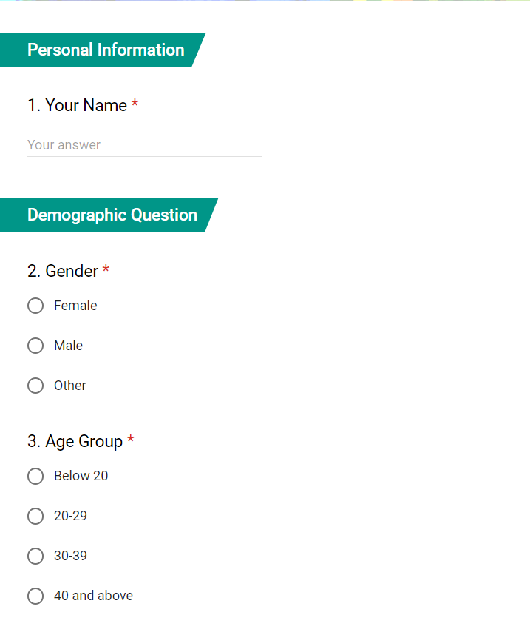
Data Collection Tool Used
The data collection tool used for the research is “Questionnaires”
Google Forms was used
August 06, 2019
Coding Cat

Slide 16
Questionnaire on ‘Coding Cat’
01
Name
Personal Information
02
Gender
Age Group
Occupation
Demographic Question
03
Internet Usage
Interests in Coding
Some Questions for talents
Some Questions for project managers
Some Opinions
Project Related Question
August 06, 2019
Coding Cat

Slide 17
Present Data Analysis Graphs
August 06, 2019
Coding Cat

Slide 18
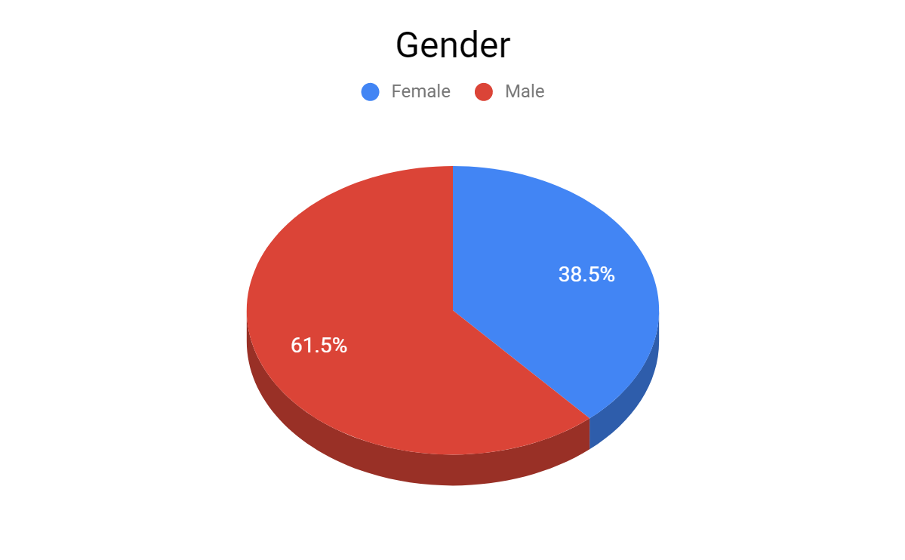
Gender
August 06, 2019
Coding Cat

Slide 19
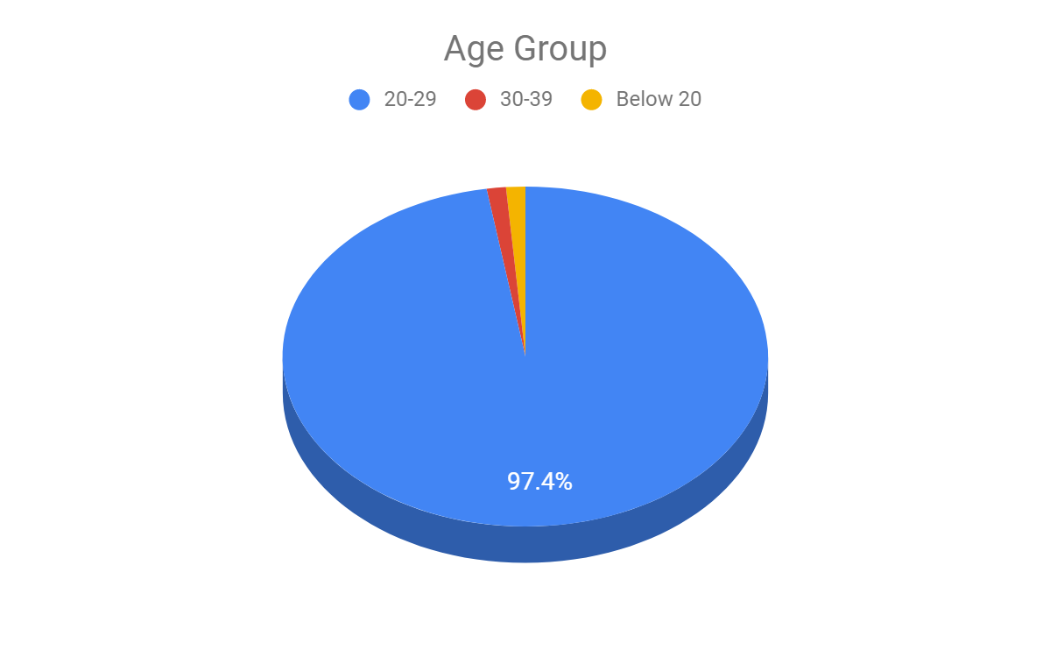
Age Group
August 06, 2019
Coding Cat

Slide 20
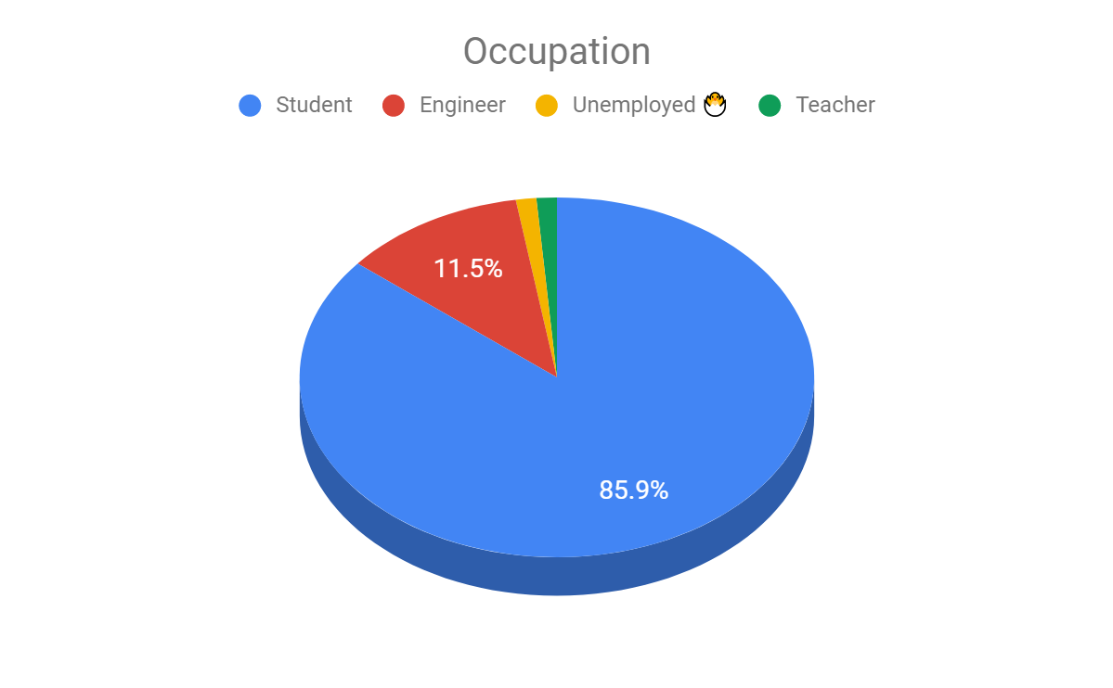
Occupation
August 06, 2019
Coding Cat

Slide 21
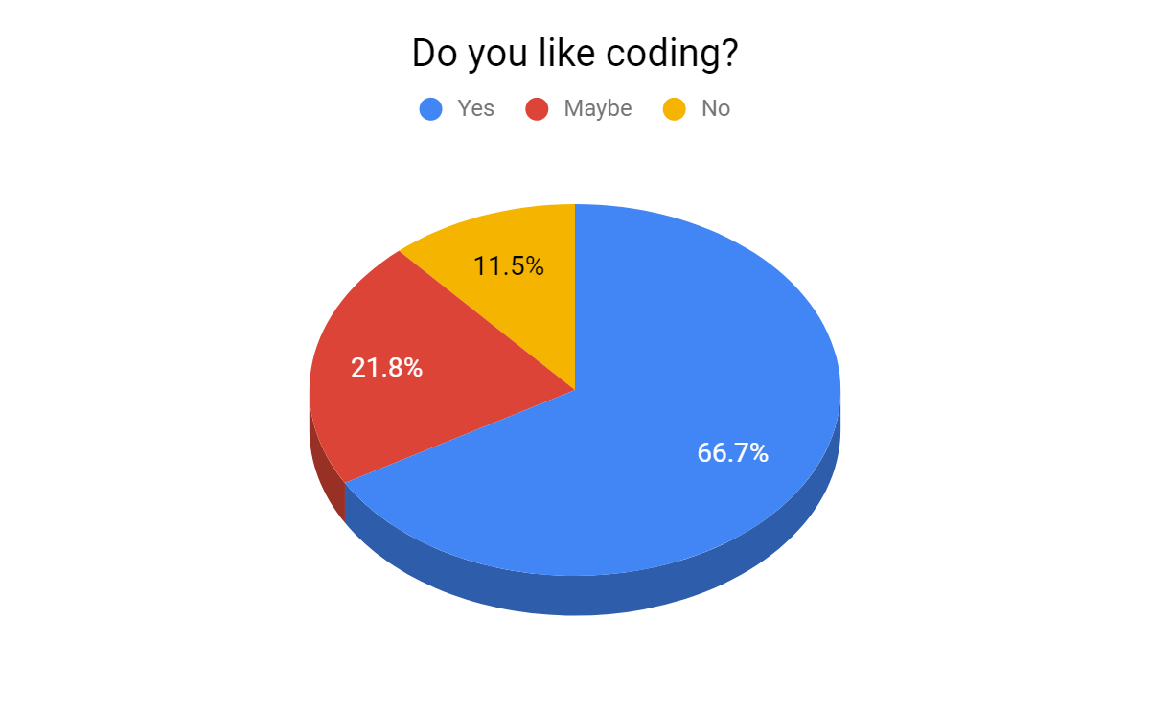
Do You Like Coding?
August 06, 2019
Coding Cat

Slide 22
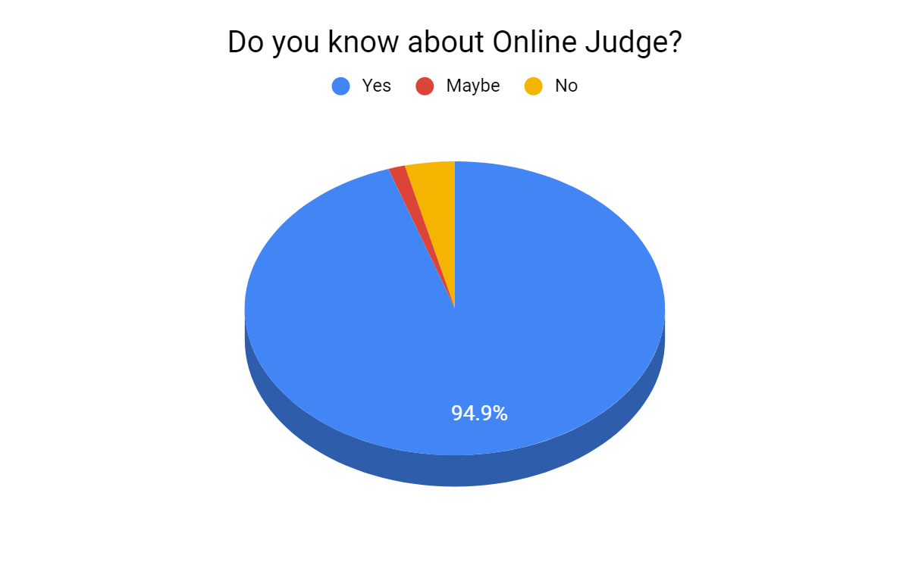
Do You Know about Online Judge?
August 06, 2019
Coding Cat

Slide 23
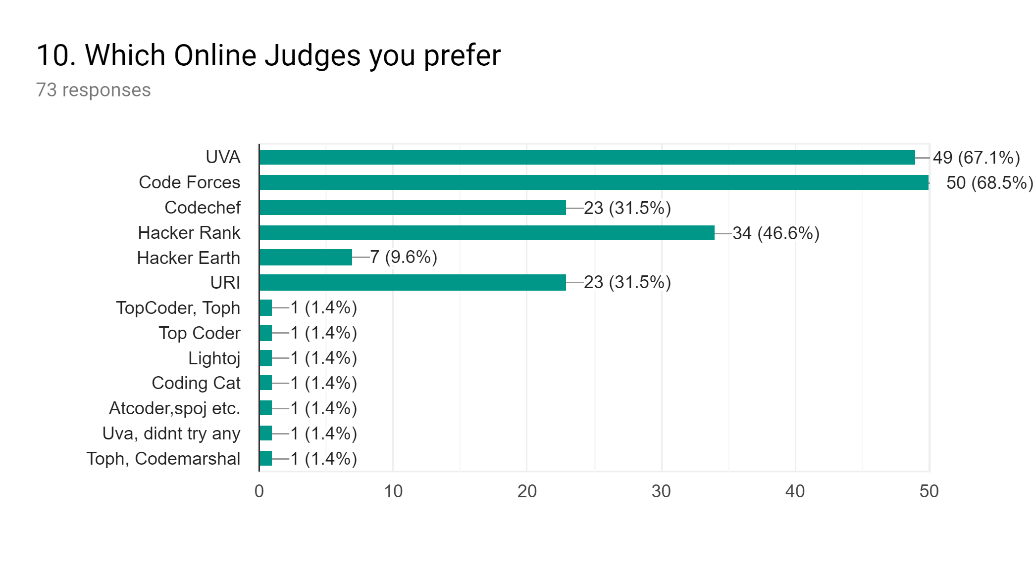
Online Judge Preferences
August 06, 2019
Coding Cat

Slide 24
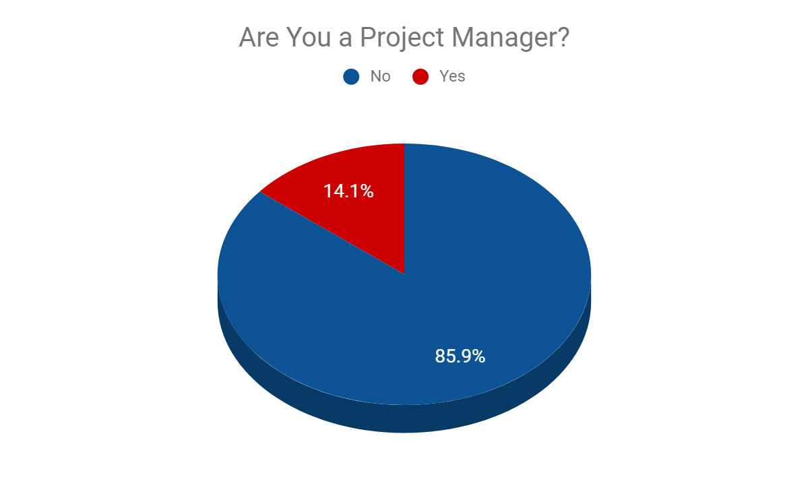
Are You a Project Manager?
August 06, 2019
Coding Cat

Slide 25
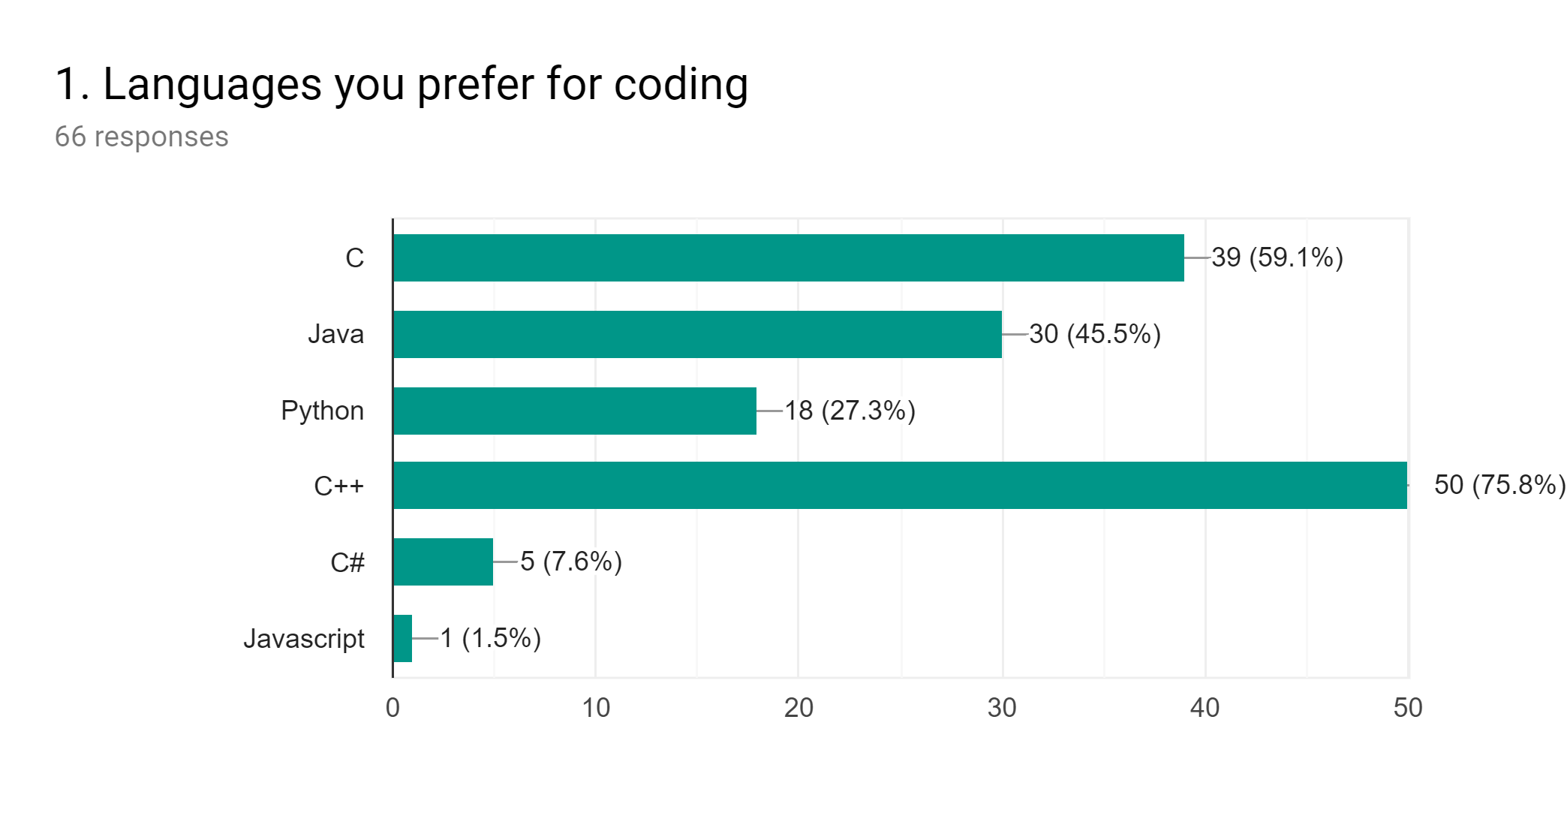
Languages You Prefer for Coding
(Talent’s Section)
August 06, 2019
Coding Cat

Slide 26
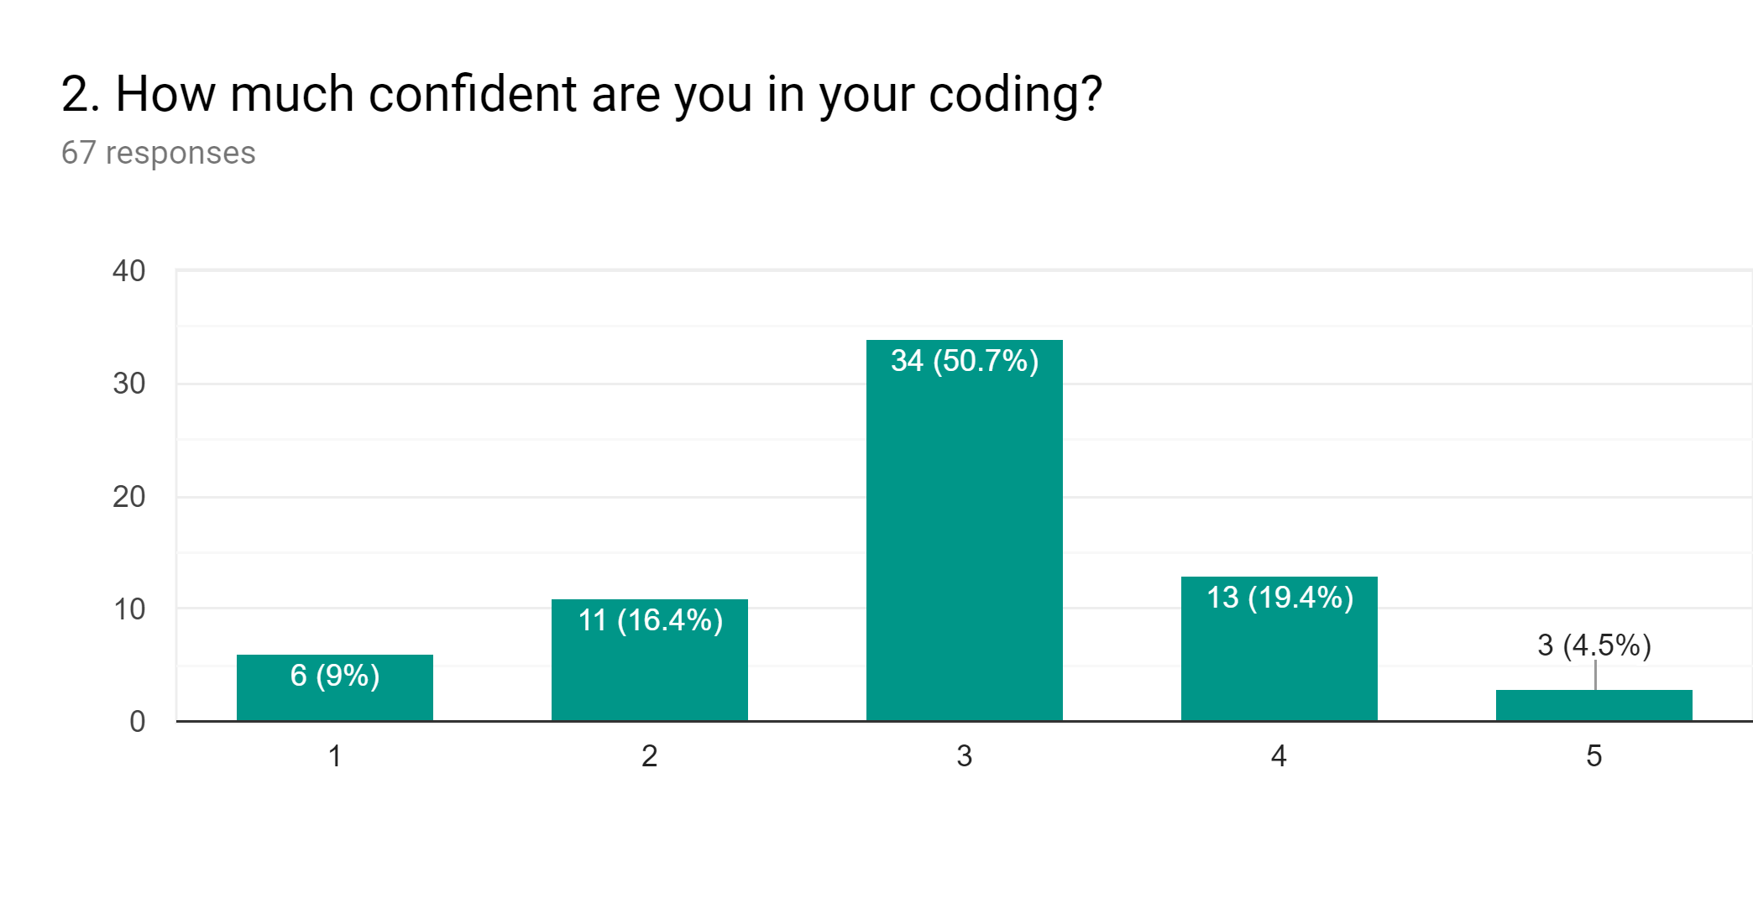
Confidence Level in Coding
(Talent’s Section)
August 06, 2019
Coding Cat

Slide 27
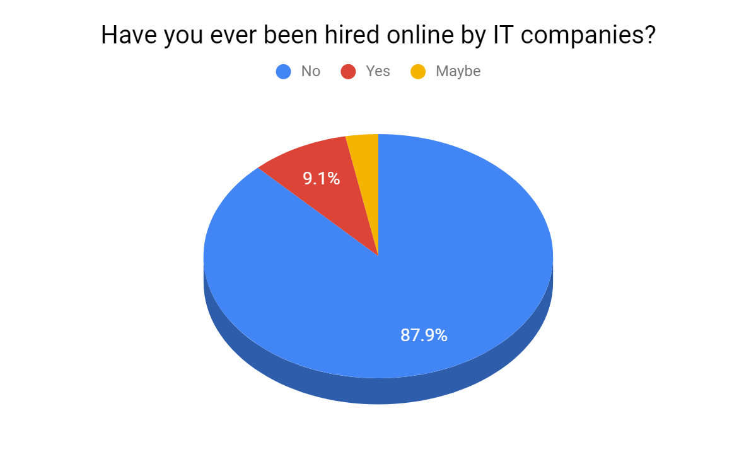
Hired online by IT Companies
(Talent’s Section)
August 06, 2019
Coding Cat

Slide 28
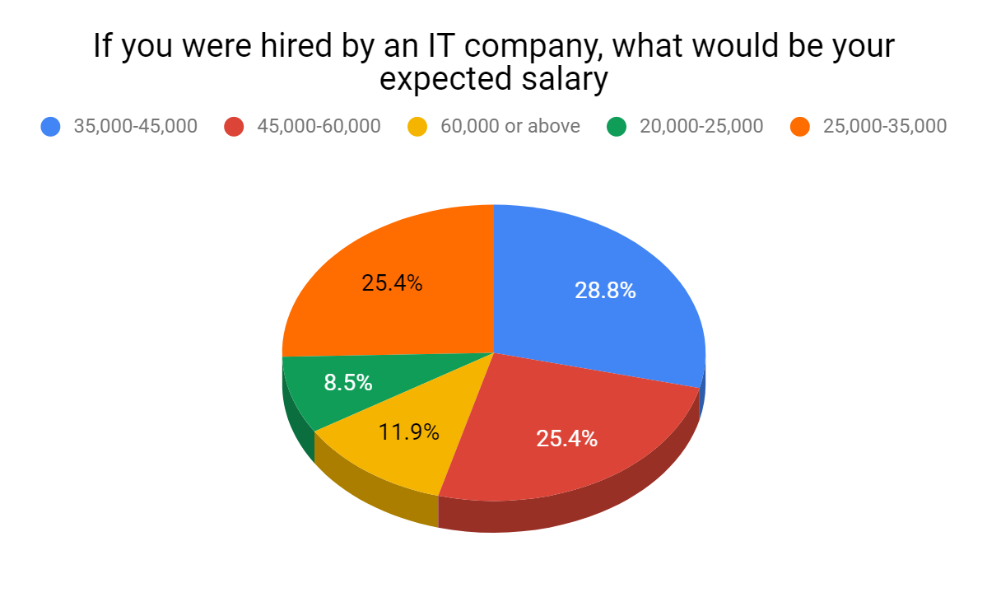
Expected salary
(Talent’s Section)
August 06, 2019
Coding Cat

Slide 29
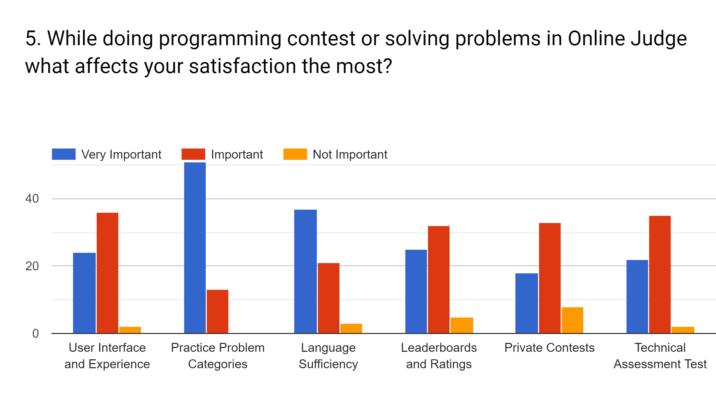
Online Judge Satisfaction
(Talent’s Section)
August 06, 2019
Coding Cat

Slide 30
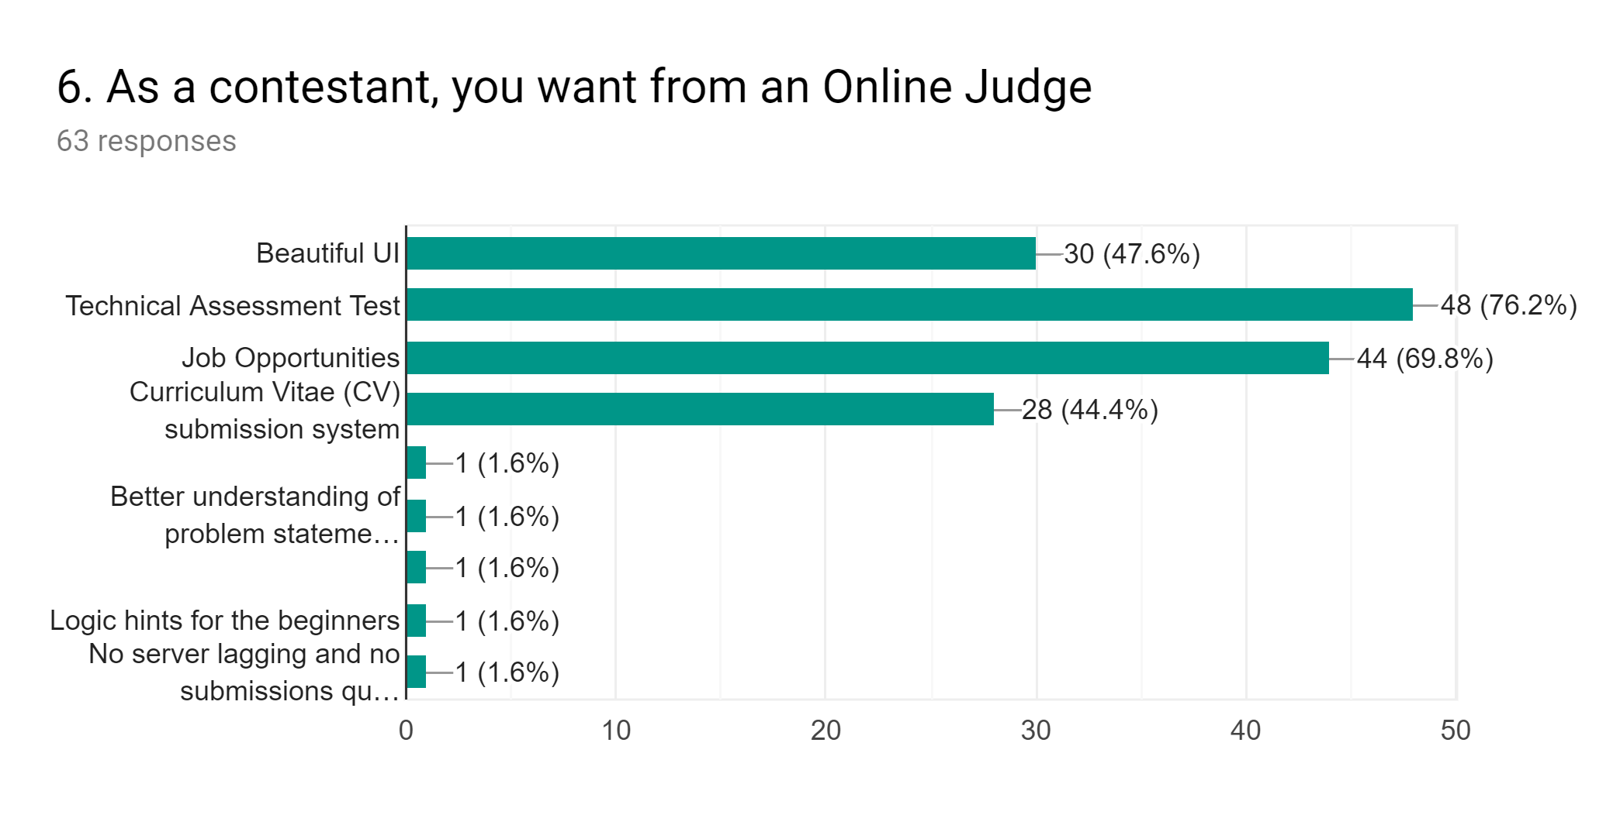
Want from an Online Judge
(Talent’s Section)
August 06, 2019
Coding Cat

Slide 31
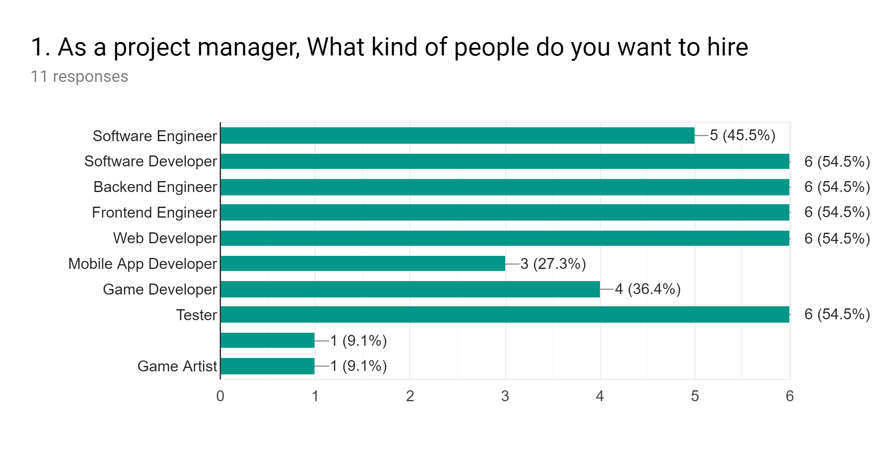
Hiring by IT Companies
(Project Manager’s Section)
August 06, 2019
Coding Cat

Slide 32
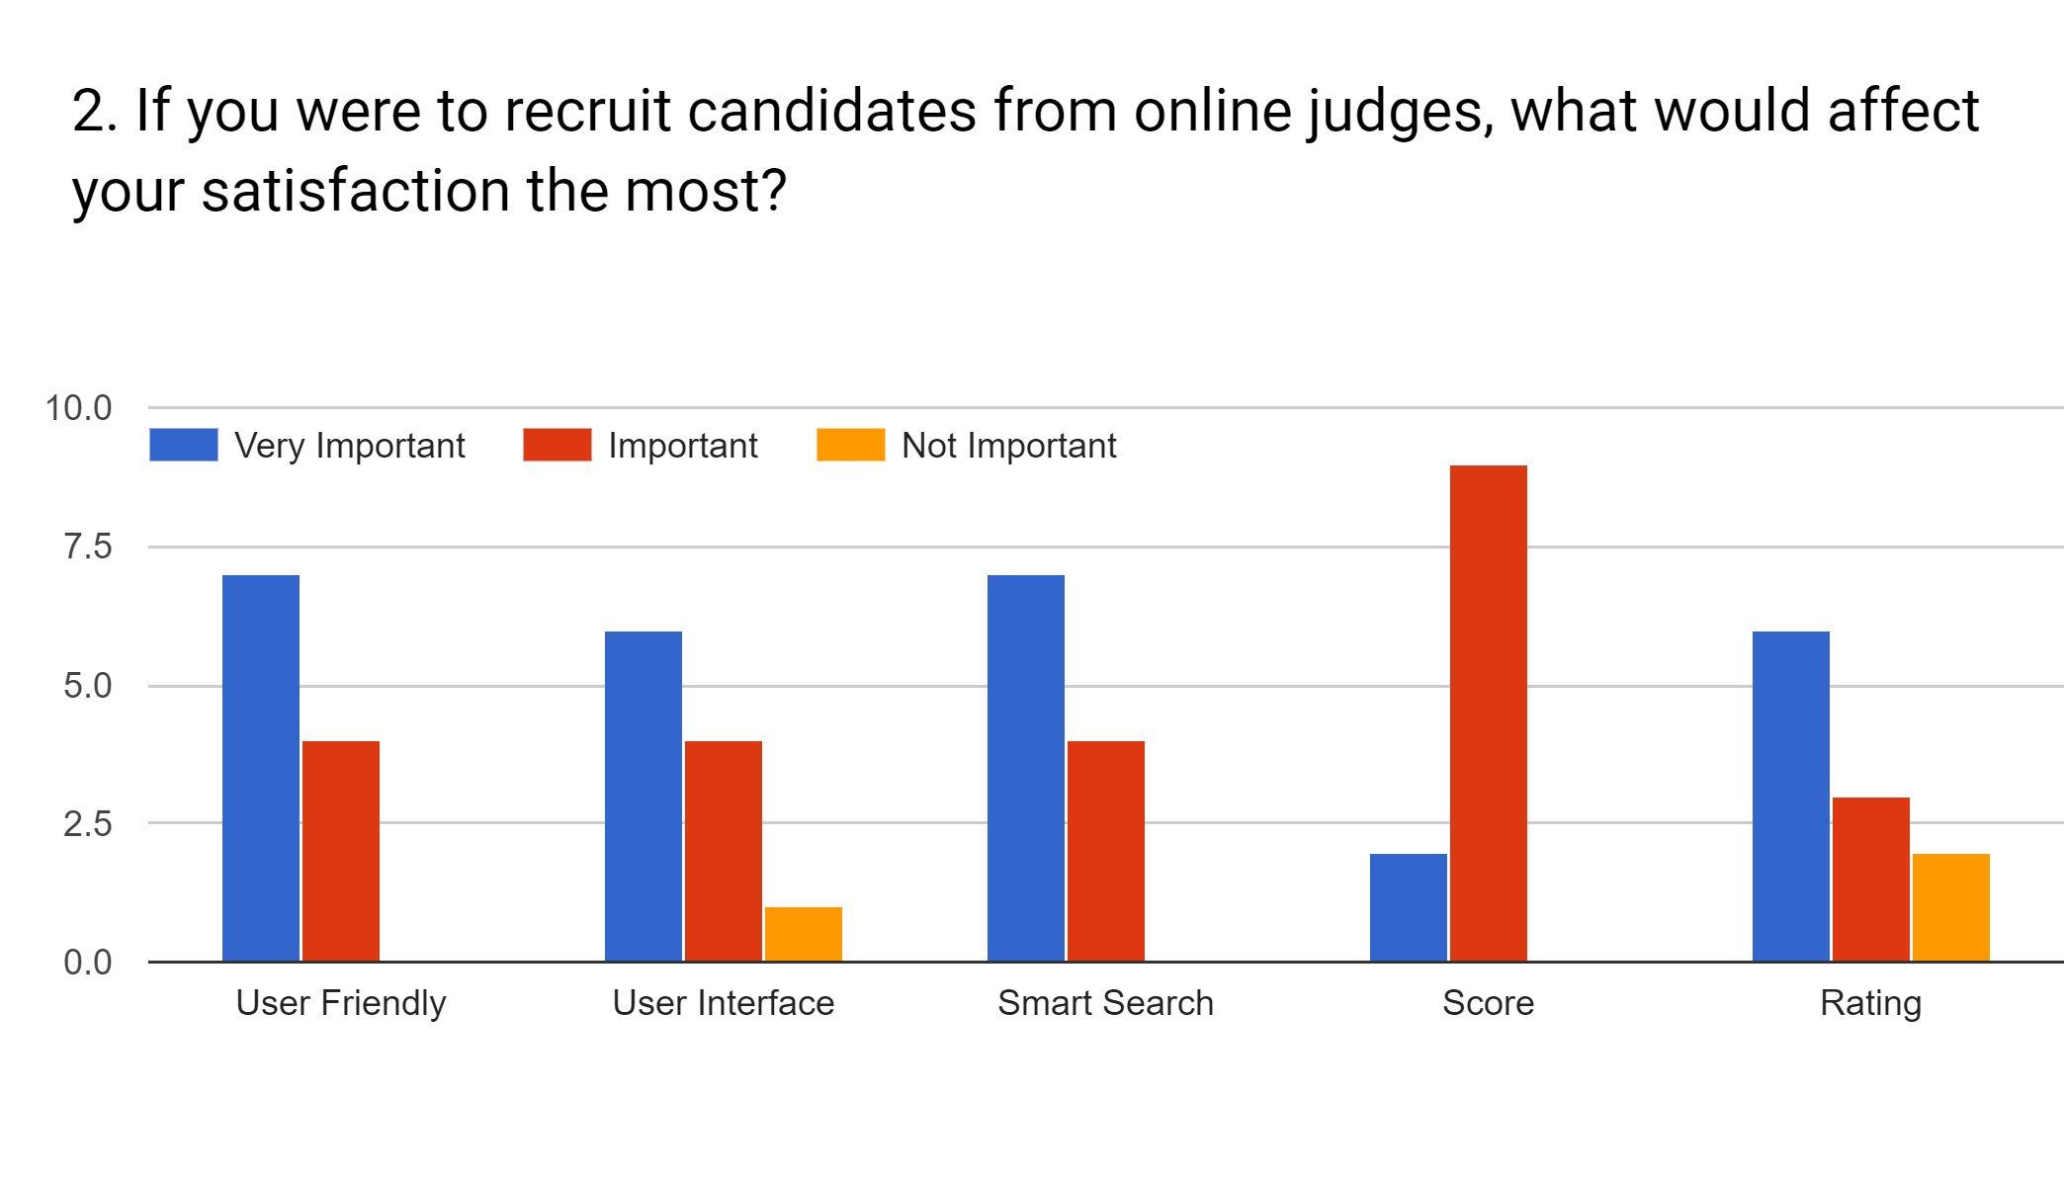
Hiring from Online Judge Satisfaction Tools
(Project Manager’s Section)
August 06, 2019
Coding Cat

Slide 33
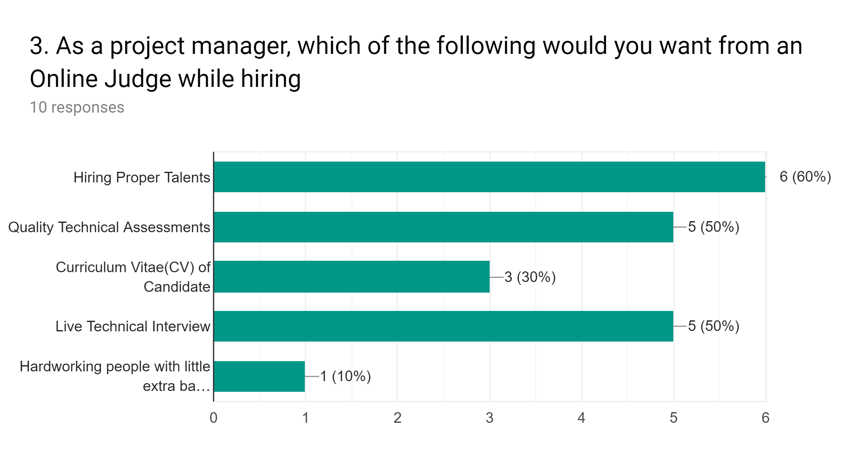
Want from Online Judge while hiring
(Project Manager’s Section)
August 06, 2019
Coding Cat

Slide 34
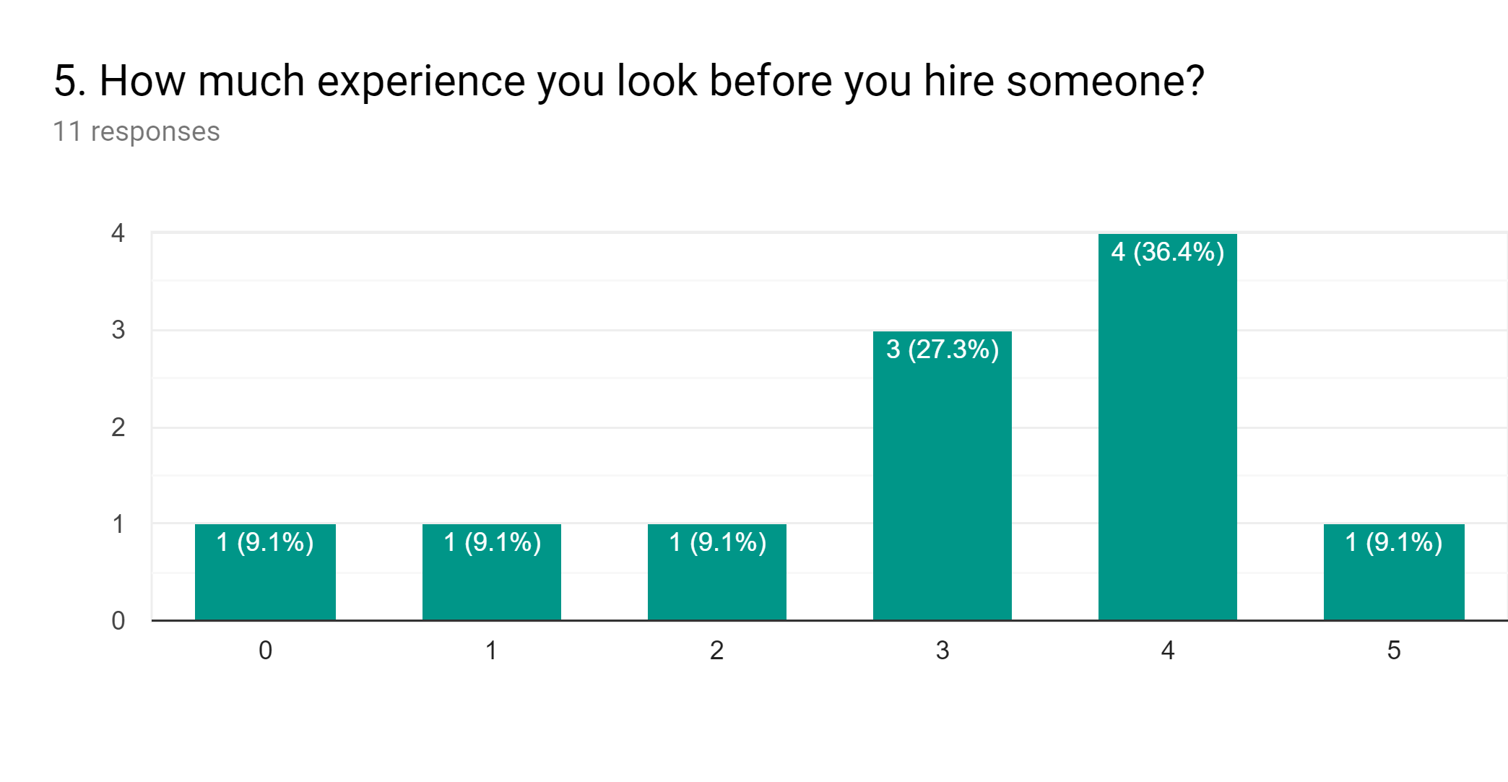
Hiring by Experience
(Project Manager’s Section)
August 06, 2019
Coding Cat

Slide 35
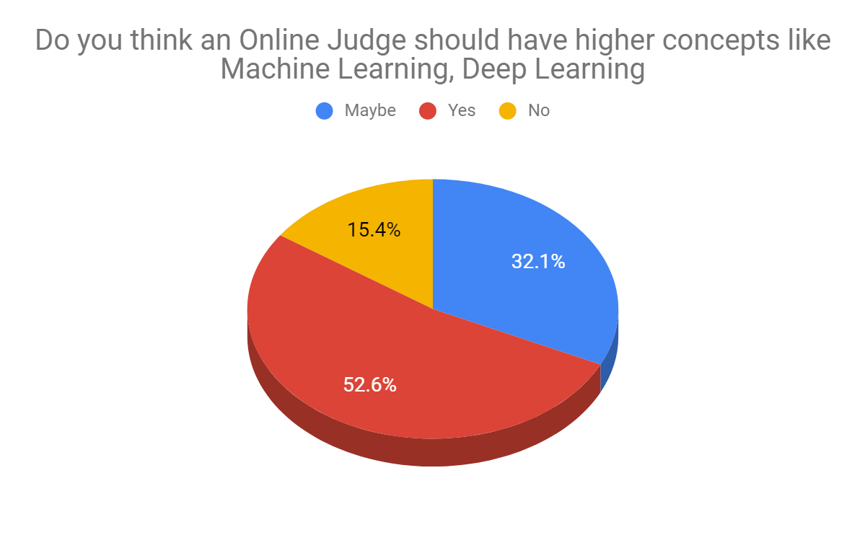
Inclusion of Higher Concepts
August 06, 2019
Coding Cat

Slide 36
Overall Findings of the Survey
Most Dominant Stakeholders: Students or Unemployed
Young adult males in the range of 20-29 most interested
Many know about Online Judge but a portion is interested
Most Preferred Language: C/C++
Most have moderate confidence in coding skills.
Most of participants were not hired by online.
Expected minimum salary BDT20,000
August 06, 2019
Coding Cat

Slide 37
Categorizing problems is the most important
The project managers need less mobile app and game developers
Adding Machine Learning supported by majority
Half of the project managers want to have a Quality Technical Assessments and Live Interview system.
Services with beautiful UI/UX is desirable
3-4 years of experience expected
August 06, 2019
Coding Cat

Slide 38
Conclusion
August 06, 2019
Coding Cat

Slide 39
Website will be a success if
Quality problems are provided
Technical Assessment Test is included
Machine Learning problems add some value
Live Interview is added
Beautiful and interactive UI/UX
August 06, 2019
Coding Cat

Slide 40

Thank You
August 06, 2019
Coding Cat

Slide 41
Any Questions?
August 06, 2019
Coding Cat

